Slide 1
Containerization & Docker Fundamentals
Srinivasan S Iyer

Slide 2
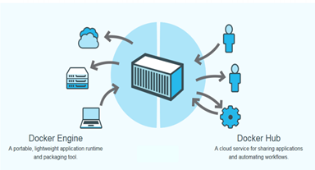
Docker
Open platform for developers and system administrators to build and test cloud applications

Slide 3
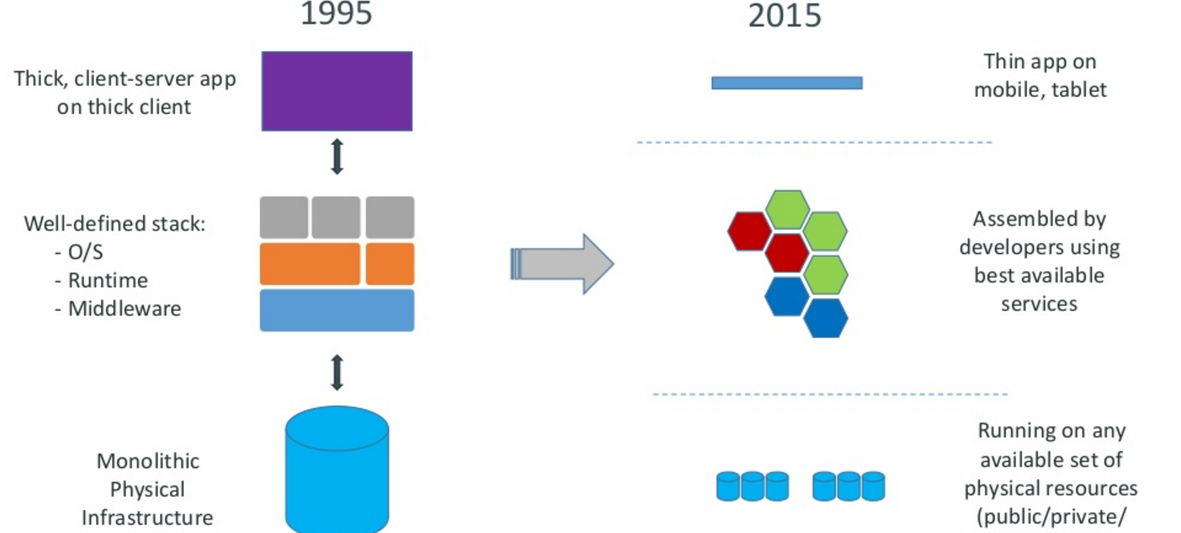
Motivation

Slide 4
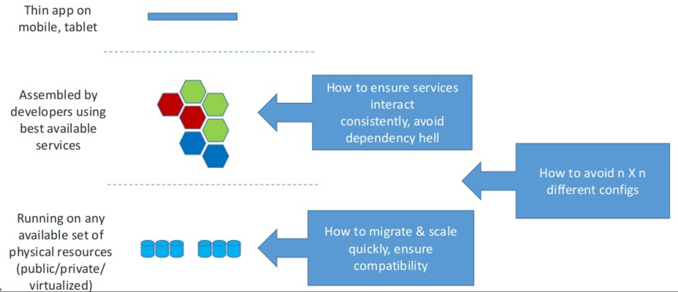
Motivation –the challenge

Slide 5
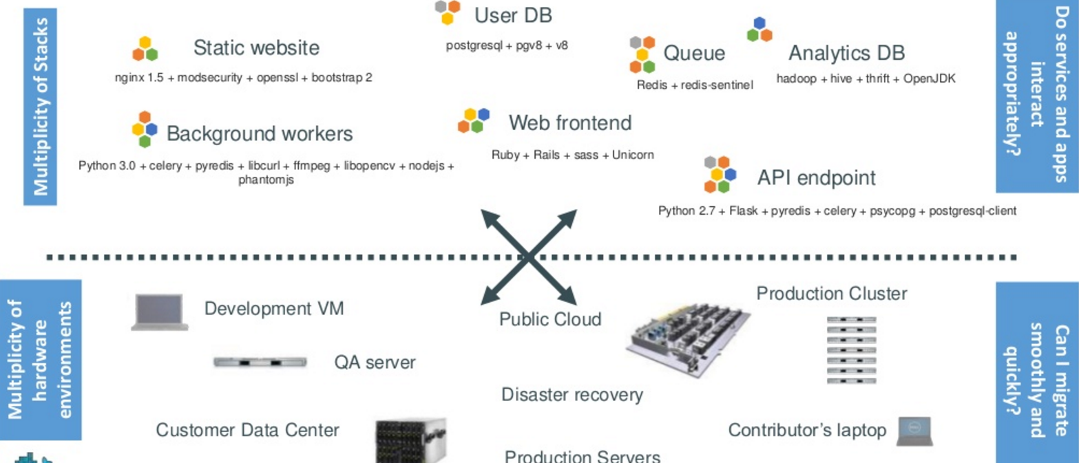
The challenge continued
Notes:
Static web: nginx is a fast webserver, generally faster than Apache
Queue: Redis = in-memory data structure store, used as a database, cache and message broker.
Analytics DB: Hadoop = Hive = Hadoop based Database, Thrift =

Slide 6
PAUSE: What were some of these technologies
Static web: nginx is a fast webserver, generally faster than Apache
Queue: Redis = in-memory data structure store, used as a database, cache and message broker.

Slide 7
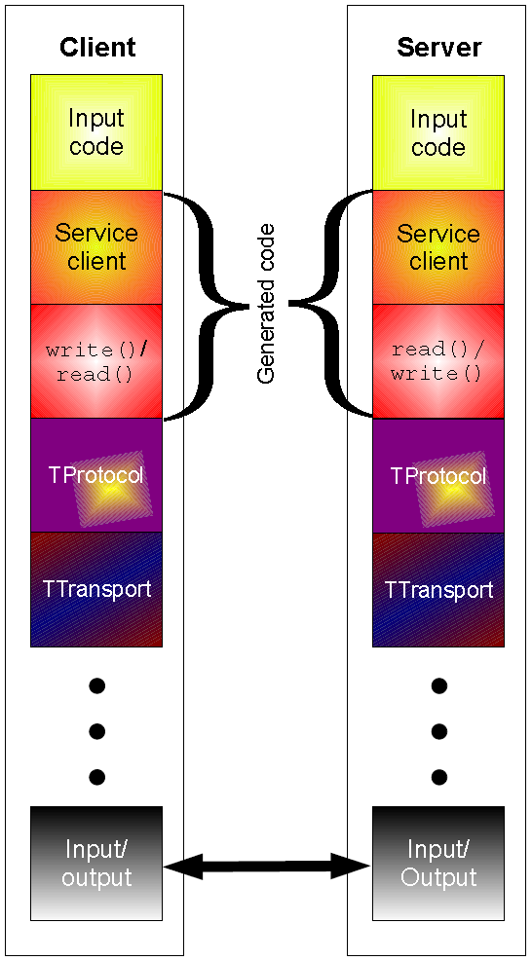
PAUSE:
Analytics DB:
Hadoop = distributed storage and processing of dataset of big data using MapReduce programming model
Hive = Hadoop based Database, offer SQL-like interfaces with HDFS-based data
---allows these database developers or data analysts to use Hadoop without knowing the Java programming language or MapReduce. Now, instead of challenging MapReduce code, you can design a star schema data warehouse or a normalized database.
Thrift = used to define and create services for numerous languages.^{[2]}
It is used as a remote procedure call (RPC) framework and was developed at Facebook for "scalable cross-language services development".

Slide 8
The challenge continued
Notes:
Static web: nginx is a fast webserver, generally faster than Apache
Queue: Redis = in-memory data structure store, used as a database, cache and message broker.
Analytics DB: Hadoop = Hive = Hadoop based Database, Thrift =

Slide 9
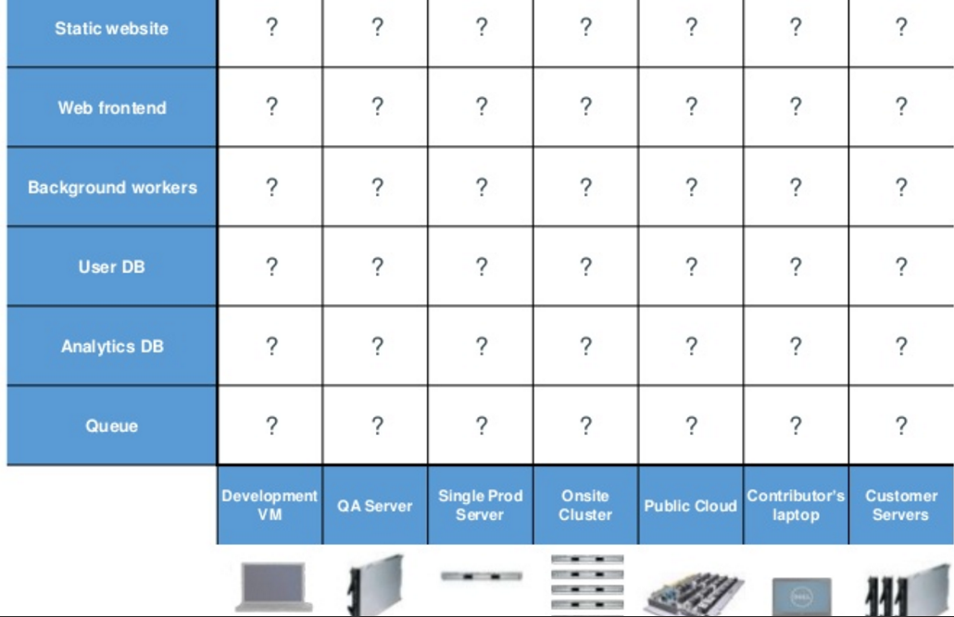
Looking for all kinds of solutions…
Too many to consider

Slide 10
THE ANSWER
Something called a CONTAINER ----which is the business Docker has created.

Slide 11
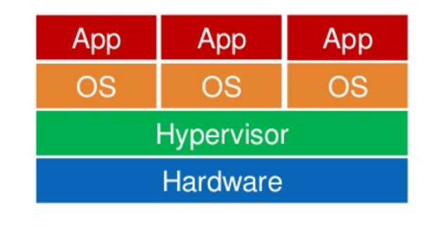
Virtualization vs Containerization

Slide 12
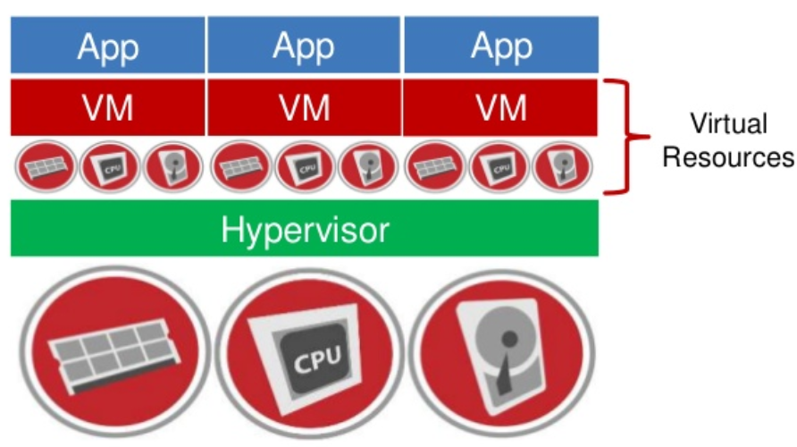
Virtualization vs Containerization

Slide 13
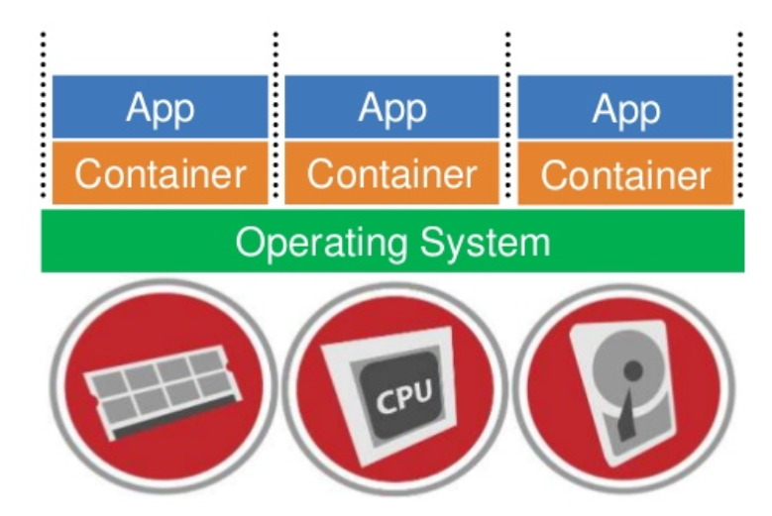
Virtualization vs Containerization

Slide 14
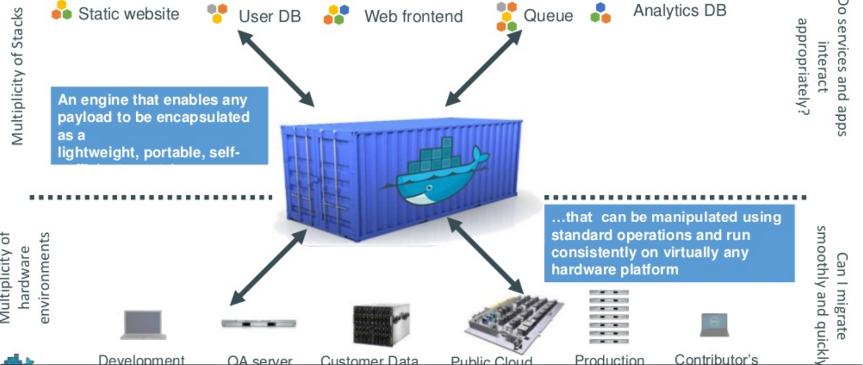
Container for code

Slide 15
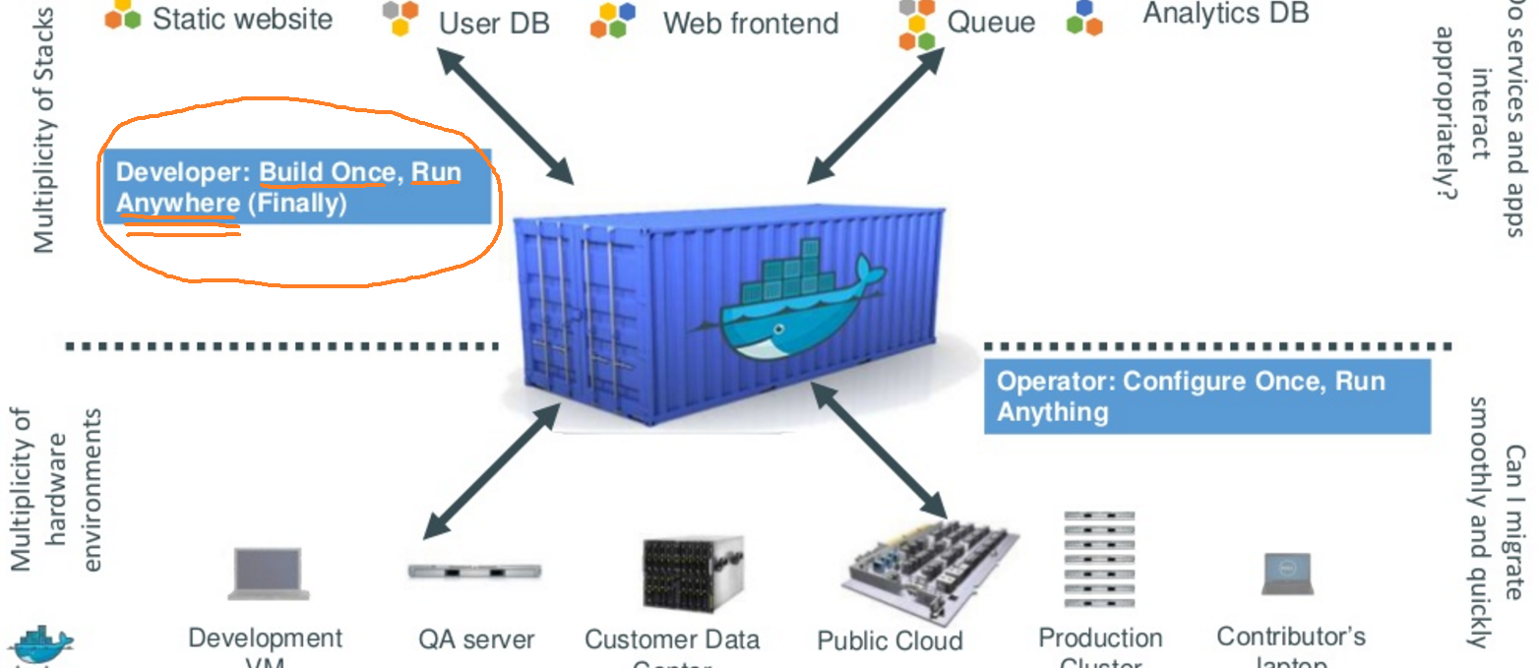
Do once run anywhere

Slide 16
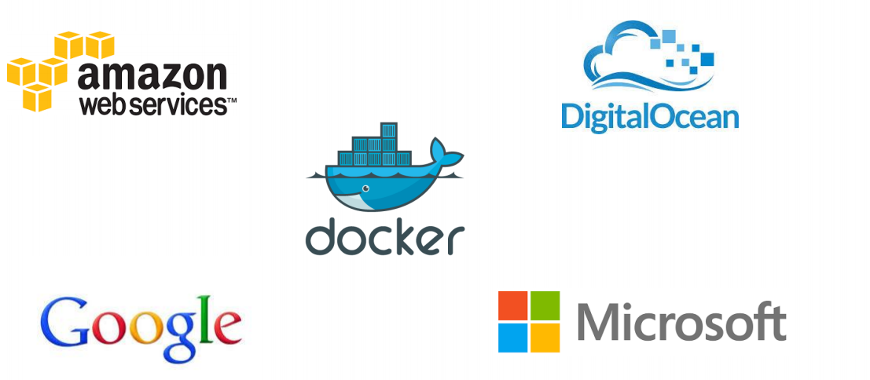
Docker supported on many Cloud platforms

Slide 17
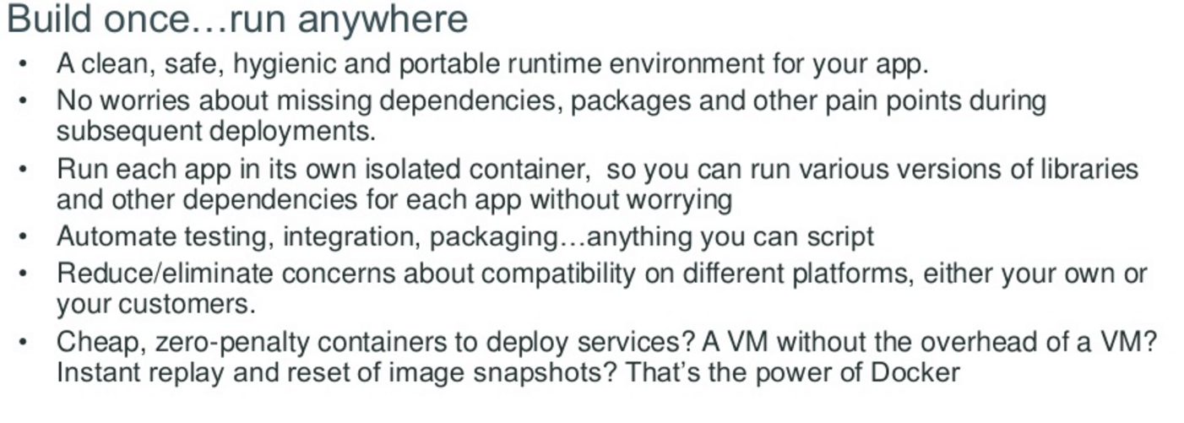
Docker container—developer viewpoint

Slide 18
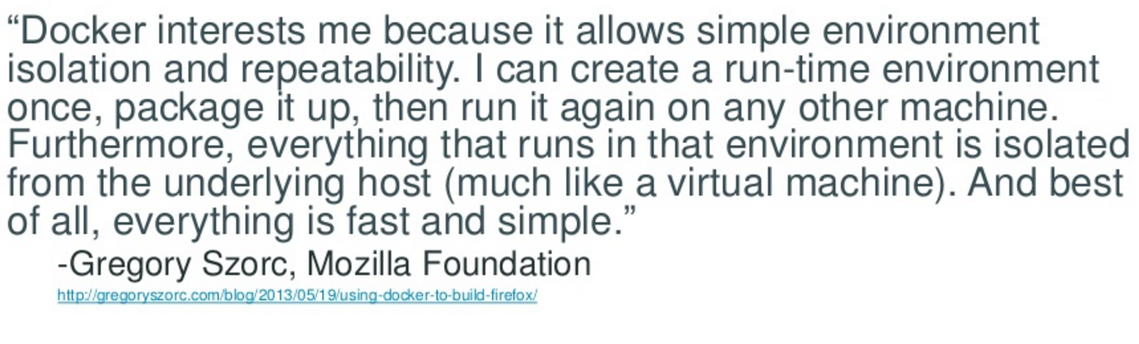
Developer viewpoint---(doesn’t this quote remind you of Java virtual machine)

Slide 19
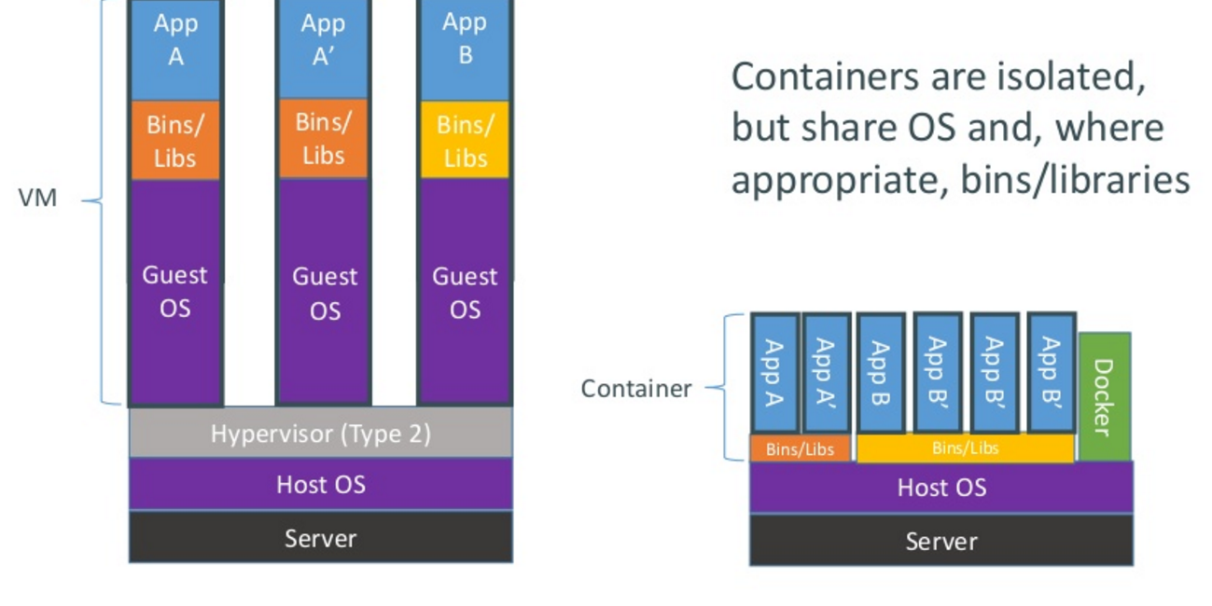
How do Docker containers work?

Slide 20
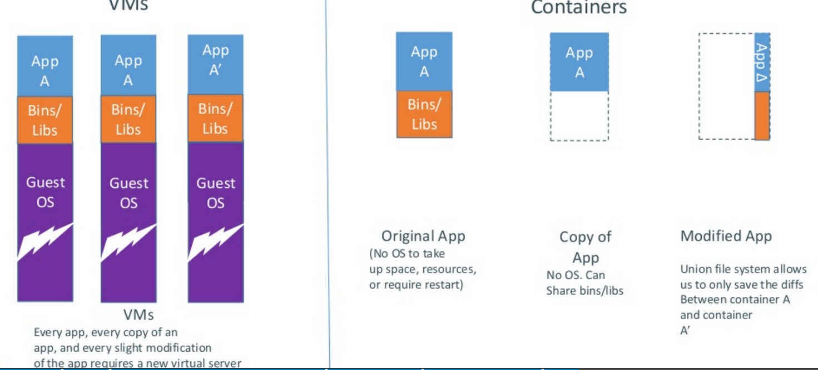
Docker containers are lightweight

Slide 21
Is Docker a PaaS or a replacement for PaaS

Slide 22
Docker versus PaaS
FIRST doesn’t have to be a comparison.. but…
For Docker: “In the case of PaaS you don’t have much control over many of the operational aspects associated with managing your application, for example the way it handles scaling, high availability, performance, monitoring, logging, updates. There is also a much stronger dependency on the platform provider in the choice of language and stack”
For PaaS, “PaaS offers additional benefits beyond application packaging and deployment, including service provisioning and binding, application monitoring and logging, automatic scaling, versioning and rollbacks, and provisioning across cloud availability zones,”

Slide 23
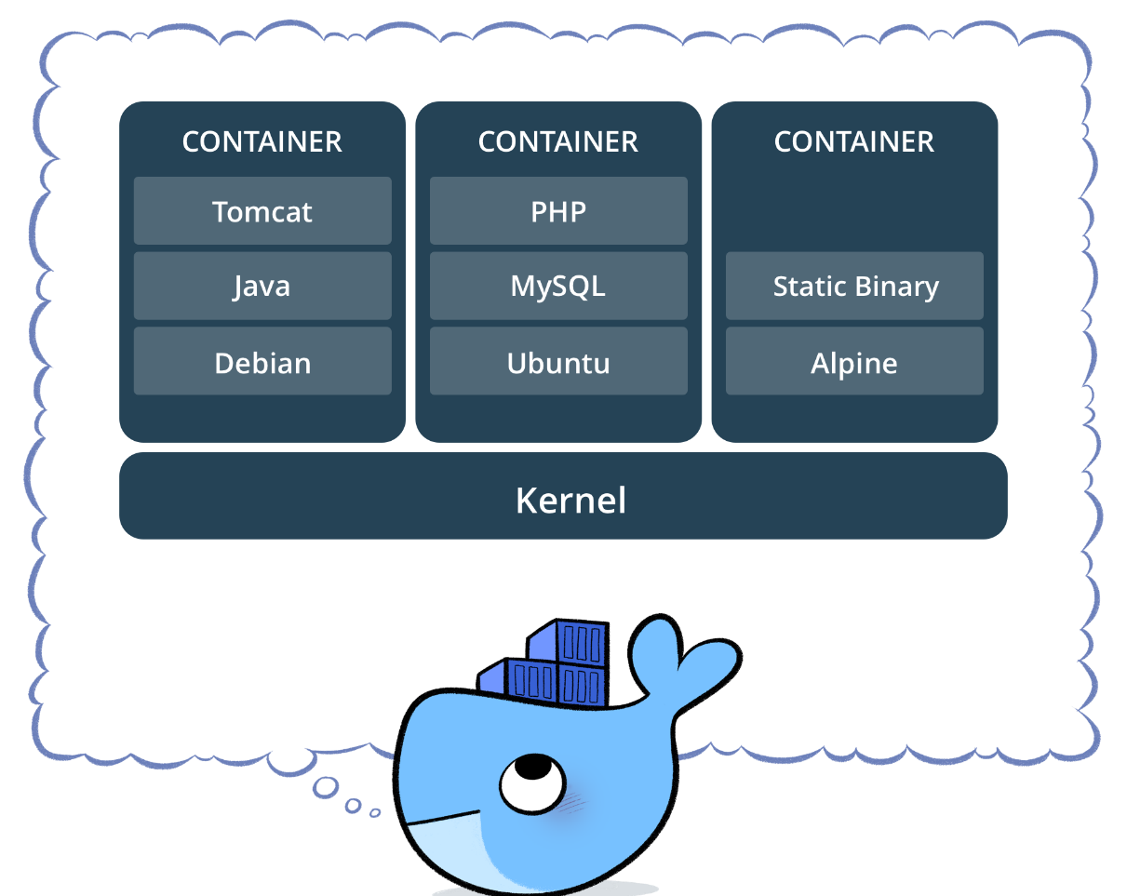
Docker versus PaaS
Docker are a “package” container that can be used on IaaS to set it up
You could use a docker to create part of the features a PaaS provides – platforms (virtual machines down to physical) that run certain software (like tomcat, php,
nodeJS, etc)
A PaaS may use docker tech to isolate different applications that users deploy to it

Slide 24
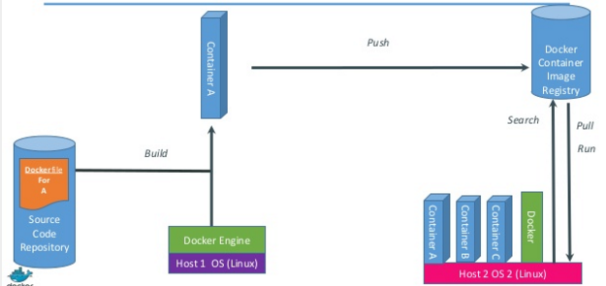
Just how does Docker work

Slide 25
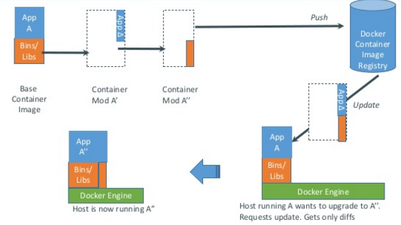
Docker updates/changes

Slide 26
Docker has a repository like github
You can push and pull container images to/from the Docker registry, which is something like a “GitHub” for Docker container images.

Slide 27
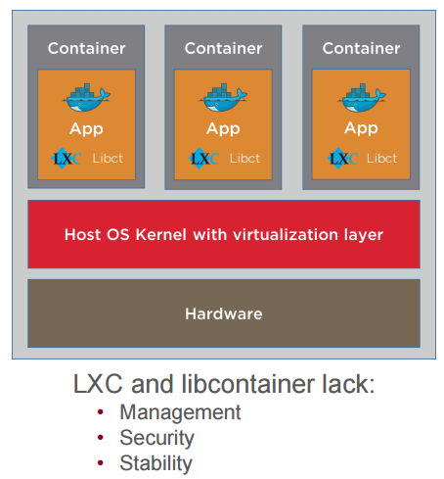
Service providers (public cloud) need containers to run Docker
Docker runs on Containers

Slide 28
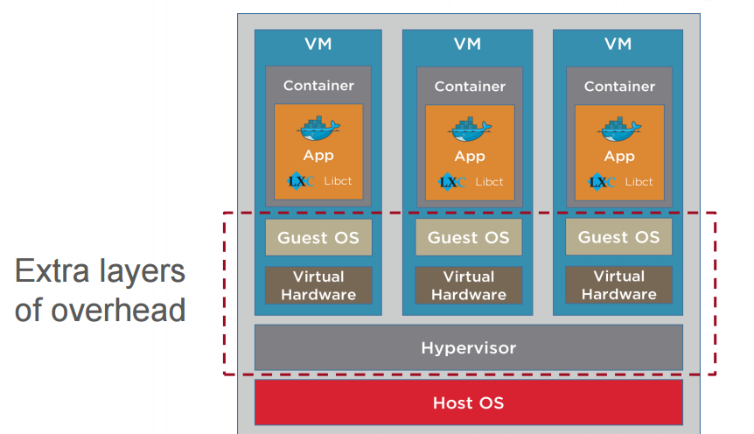
Open source Container inside VM Configuration

Slide 29
Docker & Windows Containers
Docker was originally developed on Linux, taking advantage of core Linux features, but making it simple and efficient to use containers for application workloads.
Microsoft saw the potential and worked closely with the Docker engineering team to bring the same functionality to Windows.

Slide 30
Docker & Windows Containers
Windows Server 2016 was the first version of Windows built to run Docker containers
Windows Server 2019 continues the innovation with significantly improved features and performance for Windows containers.
You can run the same Docker containers on Windows 10 for development and testing that you run on Windows Server in production.
Right now, you can only run Windows applications in containers on Windows, but Microsoft is adding support for Linux application containers to run on Windows too.

Slide 31
Docker & Windows Containers Some knowhow
Containers run differently on Windows 10 & Win Server 2019
The user experience for working with Docker is the same, but the way containers are hosted is different.
On Windows Server the process that serves your application actually runs on the server, and there's no layer between the container and the host.

Slide 32
Docker & Windows Containers Some knowhow
Windows 10 doesn't have the same operating system kernel as Windows Server 2019, so in order to provide containers with the Windows Server kernel, Windows 10 runs each container in a very light VM.
These are called Hyper-V containers, and if you run a web app in a container on Windows 10, you won't see w3wp.exe running on the host – it actually runs inside a dedicated Windows Server kernel in the Hyper-V container.

Slide 33
Working with Docker Engine
Srinivasan S Iyer

Slide 34
Docker & Windows Containers Docker Engine & Docker CLI
On the Windows Platform Docker runs as a background Windows service.
This service manages every running container – it's called the Docker Engine.
Docker Engine exposes a REST API for consumers to
work with containers and other Docker resources.
The main (native) consumer of this API is the Docker command-line tool (CLI)

Slide 35
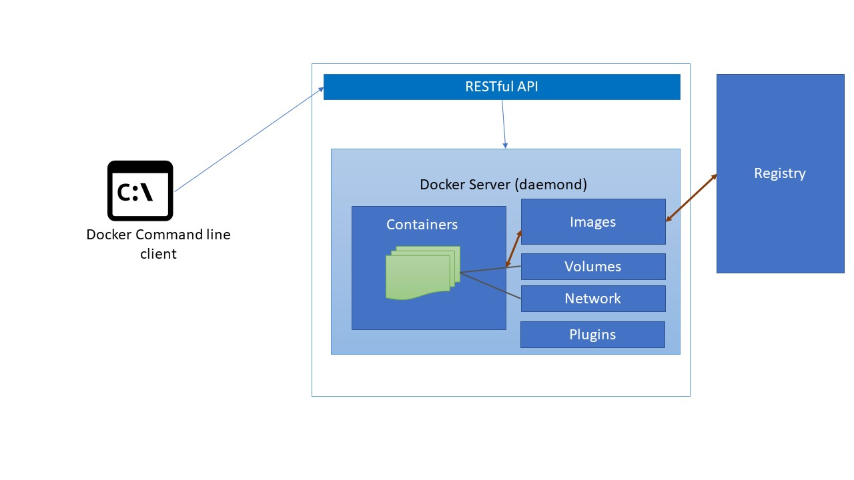
Docker & Windows Containers

Slide 36
Docker Image
A Complete Application Package
Contains an application and all is dependencies
Sharing the application is by pushing to a Docker Registry
Images are run in containers
A Docker image is like a snapshot of the filesystem for one version of your application.
Images are static, and you distribute them using an image registry

Slide 37
Docker Image – A Use Case
An ASP.NET WebForms app is going to run on Internet Information Services (IIS) in Windows Server.
To package the application in Docker
Build an image that is based on Windows Server Core
Add IIS
Then add ASP.NET runtime
Copy your application assets
and configure it as a website in IIS.
You describe all these steps in a simple script called a Dockerfile, and you can use PowerShell or batch files for each step you need to perform.

Slide 38
Docker Image – A Use Case
You build the image by running docker image build.
The input is the Dockerfile and any resources that need to be packaged into the image (like the web application content).
The output is a Docker image. In this case, the image will have a logical size of about 5 GB, but 4 GB of this will be the Windows Server Core image you're using as a base, and the image can be shared as the base across many other images.

Slide 39
Docker – Image Registries
A registry is a storage server for Docker images. Registries can be public or private, and there are free public registries and commercial registry servers which allow fine-grained
access control for images.
Images are stored with a unique name within the registry.
Anyone with access can upload an image by running
docker image push
Images can be download by running
docker image pull.

Slide 40
Docker – Popular Image Registries
Docker Hub is the default registry, and it has become hugely popular for open source projects, for commercial software, and for teams working on private projects.
There are hundreds of thousands of images stored on Docker Hub, which serves billions of pull requests every year..
Microsoft Container Registry (MCR) is where Microsoft host their own Docker images for Windows Server Core and Nano Server, along with images preconfigured with the .NET Framework.
Microsoft's Docker images are free to download and use. They only run on Windows machines, which is where the Windows licensing is applied.

Slide 41
Docker Containers
.
A container is an instance of an application created from an image.
The image contains the whole application stack, and it also specifies the process to start the application, so Docker knows what to do when you run a container.
You can run multiple containers from the same image, and you can run containers in different ways.
You start your application with
docker container run
And specifying the name of the image and your configuration options.

Slide 42
Docker Containers - Workflow
.
Distribution is built into the Docker platform.
If you don't have a copy of the image on the host where you're trying to run the container, Docker will pull the image first.
Then it starts the specified process, and your app is running in a container.

Slide 43
Docker Containers - Workflow
.
Distribution is built into the Docker platform.
If you don't have a copy of the image on the host where you're trying to run the container, Docker will pull the image first.
Then it starts the specified process, and your app is running in a container.

Slide 44
Docker Containers – Memory?
.
Containers don't need a fixed allocation of CPU or memory, and the processes for your application can use as much of the host's compute power as they need.
You can run dozens of containers on modest hardware, and unless the applications all try to use a lot of CPU at the same time, they will happily run concurrently.
You can also start containers with resource limits to restrict how much CPU and memory they have access to.

Slide 45
Docker Containers – Availability?
.
Docker provides the container runtime, as well as image packaging and distribution.
In a small environment and in development, you will manage individual containers on a single Docker host, which could be your laptop or a test server.
When you move to production, you'll need high availability and the option to scale, and that comes with an orchestrator
like Docker Swarm.

Slide 46
Docker Swarm
.
Docker has the ability to run on a single machine or as one node in a cluster of machines all running Docker.
This cluster is called a Swarm, and you don't need to install anything extra to run in swarm mode.
You install Docker on a set of machines –
on the first, you run
docker swarm init to initialize the swarm
on the others you run
docker swarm join to join the swarm.

Slide 47
Dockers & K8s – Quick Compare
.
Docker Swarm is a very popular container orchestrator, but it isn't the only one.
Kubernetes is one alternative that has seen huge growth, with most public clouds now offering a managed Kubernetes service.

Slide 48
Demo
Install and Configure Docker
Understand theSettings
Shift between Windows and Linux Containers
Login to DockerHub
Use the Docker CLI
Run some docker commands
Download Visual Studio Code & Install

Slide 49
Building Docker Images 1
Srinivasan S Iyer

Slide 50
Building a Docker Image
Docker images are layered.
The bottom layer is the operating system, which can be a full
OS like Windows Server Core, or a minimal OS like Microsoft Nano Server.
On top of this are layers for each change you make to the base OS when you build an image, by installing software, copying files, and running commands.
Logically, Docker treats the image as a single unit, but physically each layer is stored as a separate file in Docker's cache, so images with a lot of common features can share layers from the cache.

Slide 51
Building a Docker Image
Images are built using a text file with the Dockerfile language Starts by specifying the base OS image with and all the steps to add on top.
The language is very simple, and there are only a few commands you need to master in order to build production-grade images

Slide 52
Understanding a Docker File
A Dockerfile is just a deployment script which packages software into a Docker image.
FROM mcr.microsoft.com/windows/servercore:ltsc2019
COPY scripts/print-env-details.ps1 C:\\print-env.ps1
CMD ["powershell.exe", "C:\\print-env.ps1"]
Uses an image called windows/servercore as the starting point for this image, specifying the ltsc2019 version of the image and the registry where it is hosted
Copies the PowerShell script from the local computer to a specific location in the image
Specifies the startup command when a container runs, which in this case is running the PowerShell script.

Slide 53
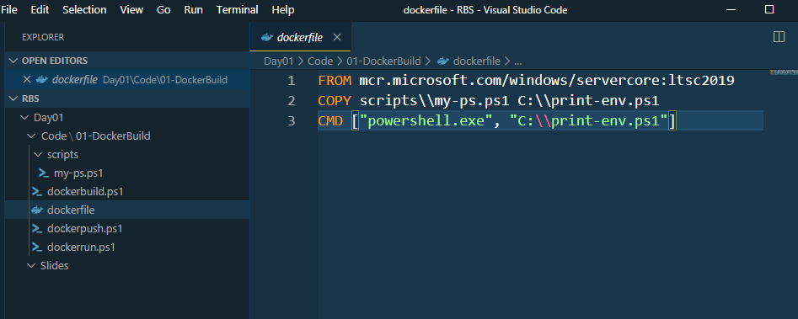
Dockerfile

Slide 54
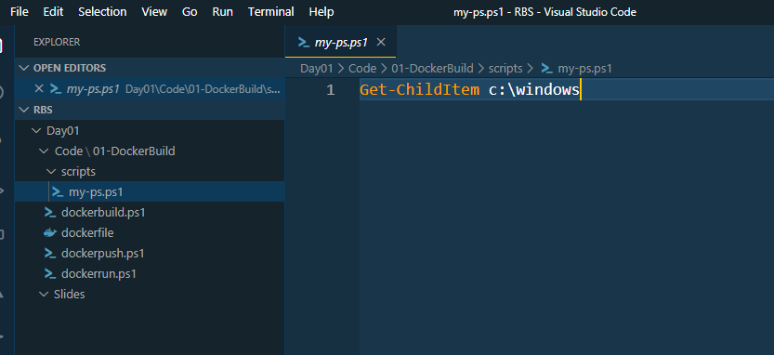
my-ps.ps1

Slide 55
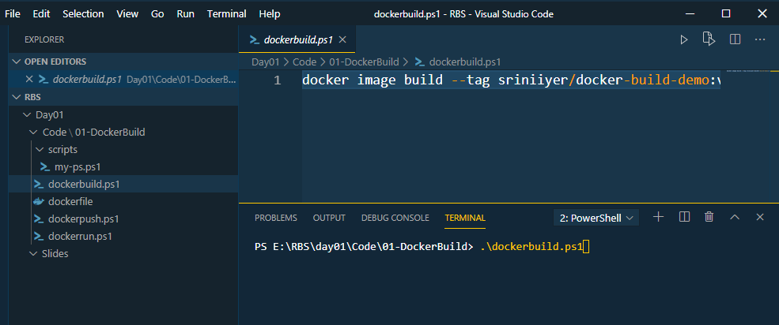
Dockerbuild.ps1

Slide 56
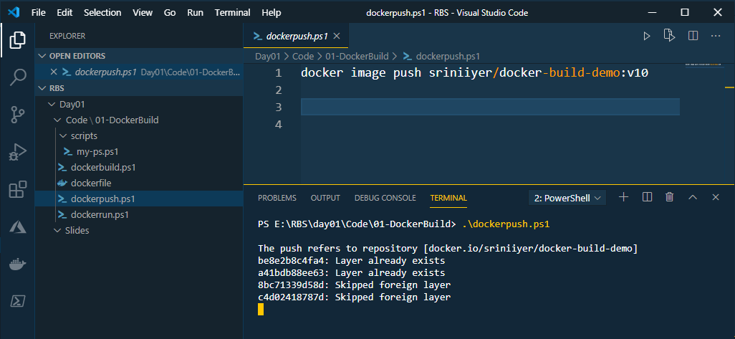
Dockerpush.ps1

Slide 57
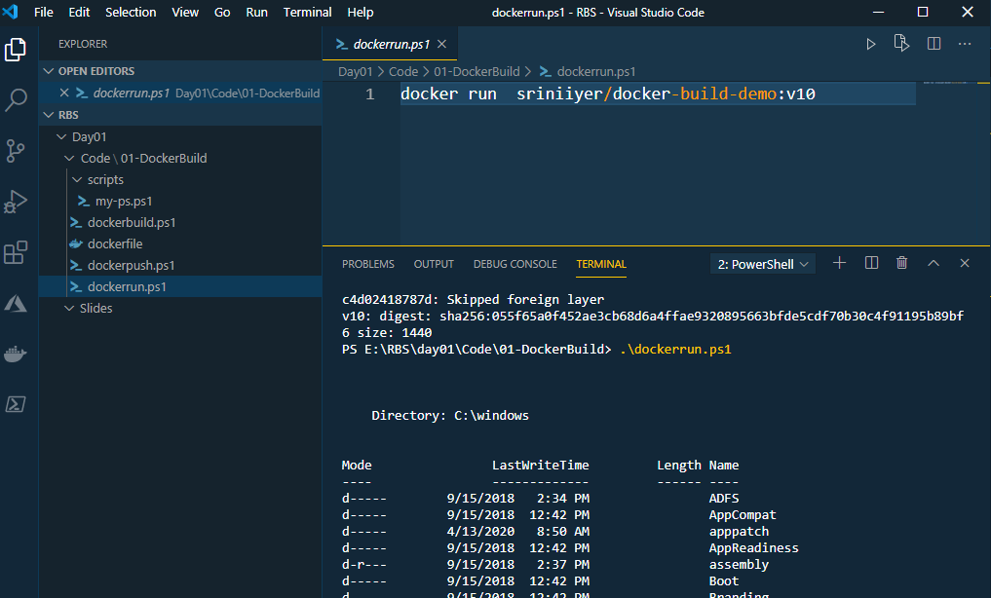
Dockerun.ps1

Slide 58
Demo – Building Docker Images
Create the Folder Structure
Create the Application – my-ps.ps1
Build Docker image using dockerbuild.ps1
Push Docker image to Docker Hub Registry using dockerpush.ps1
Run the image using dockerrun.ps1

Slide 59
Building Docker Images 2 Packaging a .NET Core App

Slide 60
Creating the Folder Structure and the Console App
Create a folder 02-DotNetCoreApp
mkdir dotnetapp
dotnet new console
dotnet restore
dotnet run

Slide 61
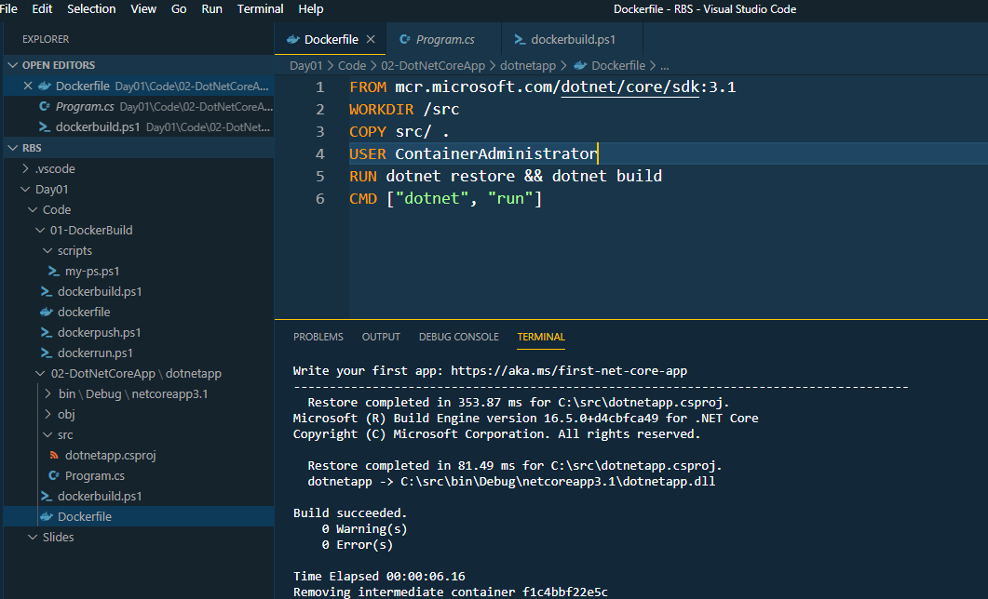
Dockerfile

Slide 62
Dockerfile - Multistage
# build stage
FROM mcr.microsoft.com/dotnet/core/sdk:3.1 AS builder
WORKDIR /src
COPY src/ .
USER ContainerAdministrator
RUN dotnet restore && dotnet publish
# final image stage
FROM mcr.microsoft.com/dotnet/core/sdk:3.1
WORKDIR /dotnetapp
COPY --from=builder /src/bin/Debug/netcoreapp3.1/publish .
CMD ["dotnet", "dotnetapp.dll"]

Slide 63
Deploying a Static WebSite to Docker with IIS & Run Arguments

Slide 64
template.html
<html>
<title>
This is: {environment}
</title>
<body>
<h1>Hello from {hostname}!</h1>
</body>
</html>

Slide 65
Dockerfile
# escape=`
FROM mcr.microsoft.com/windows/servercore/iis:windowsservercore-ltsc2019
SHELL ["powershell"]
ARG ENV_NAME=DEV
EXPOSE 80
COPY template.html C:\template.html
RUN (Get-Content -Raw -Path C:\template.html) `
-replace '{hostname}', [Environment]::MachineName `
-replace '{environment}', [Environment]::GetEnvironmentVariable('ENV_NAME') `
| Set-Content -Path C:\inetpub\wwwroot\index.html

Slide 66
DockerBuild.ps1
docker image build --build-arg ENV_NAME=TEST --tag sriniiyer/docker-iis-staticweb:v10 .
Dockerrun.ps1
docker container run --detach --publish 8081:80 sriniiyer/docker-iis-staticweb:v10

Slide 67
Temporary Containers & Image State

Slide 68
Temporary Docker Containers
Docker executes every build instruction inside a temporary, intermediate container
The RUN instruction to generate the HTML ran in a temporary container, so the PowerShell script wrote that container's ID as the hostname in the HTML file; this is where the container ID came from.
The intermediate container gets removed by Docker, but the HTML file it created persists within the image
When you build a Docker image, the instructions execute inside temporary containers.
The containers are removed, but the state they write persists
within the final image and will be present in any containers you run from that image

Slide 69
Working with data in Docker images and containers

Slide 70
Data in layers and the virtual C drive
The virtual filesystem is how Docker can take a set of physical image layers and treat them as one logical container image.
Image layers are mounted as read-only parts of the filesystem in a container, so they can't be altered, and that's how they can be safely shared by many containers.
Each container has its own writeable layer on top of all of the read-only layers, so every
container can modify its own data without affecting any other containers

Slide 71
Base Docker File
# escape=`
FROM mcr.microsoft.com/windows/nanoserver:1809
RUN md c:\data & `
echo 'from image 1' > c:\data\file1.txt
docker build --tag sriniiyer/fs-demo:v10 .
Dependent Docker File
FROM sriniiyer/fs-demo:v10
RUN echo 'from image 2' > c:\data\file2.txt
docker build --tag sriniiyer/fs-demo:v11 .
docker container run -it --name c1 sriniiyer/fs-demo:v11

Slide 72
Working with Docker Volumes

Slide 73
Using Volumes to Share Data
Volumes are units of storage.
They have a separate life cycle to containers, so they can be created independently and then mounted inside one or more containers.
You can ensure containers are always created with volume storage using the VOLUME instruction in the Dockerfile.
Volumes are always defined in the base image C Drive

Slide 74
Dockerfile with Volume Instruction
# escape=`
FROM mcr.microsoft.com/windows/nanoserver:1809
VOLUME C:\app\config
VOLUME C:\app\logs
USER ContainerAdministrator
ENTRYPOINT cmd /S /C
docker build --tag sriniiyer/volume-demo:v10 .
docker container run --name source sriniiyer/volume-demo:v10 "echo 'start' > c:\app\logs\log-1.txt"
docker container run -it --volumes-from source sriniiyer/volume-demo:v10 cmd

